Slide 1

car plate detector

Slide 2
Project Members
Eissa Islam 94072
Ebrahim Mostafa 94273
Youssef Mohamed 98048
Abdelfatah Ashraf 90364
Khaled Fady 94244

Slide 3


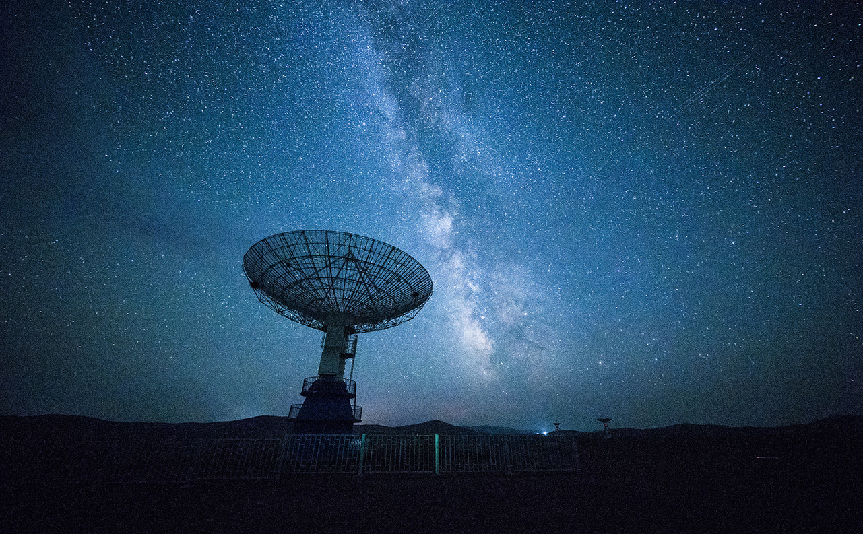
What is car plate detector?
Vehicle Number Plate Detection aims at detection of the License Plate present on a vehicle and then extracting the contents of that License Plate. A vehicle’s license plate is commonly known as ‘a number plate’. It is a metal plate that is attached to a vehicle and has the official registration number of a vehicle embossed on it. Number plates are placed at the front and back of the vehicle and help anyone to identify a vehicle.

Slide 4
The main idea of the project !
Recognizing a Car License Plate is a very important task for a camera surveillance-based security system. We can extract the license plate from an image using some computer vision techniques and then we can use Optical Character Recognition to recognize the license number. Here I will guide you through the whole procedure of this task.

Slide 5



Now let's look on the code and how we have done this project

Slide 6
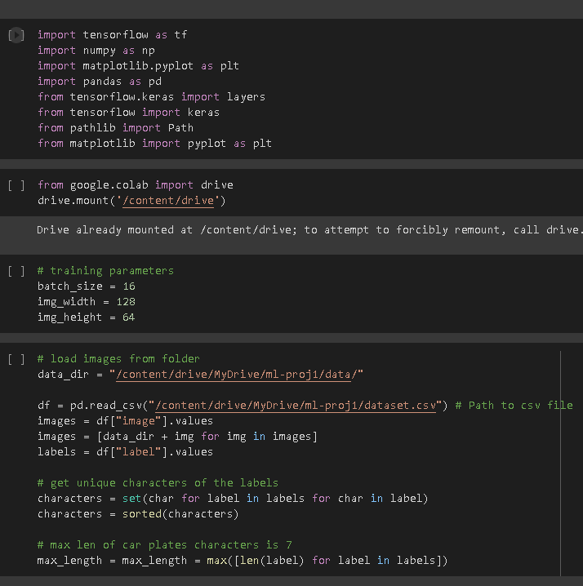
Here we use our libraries for our neural network
And we defined our batch size and image width , height
We loaded our images folder from the drive and loaded our labels also

Slide 7
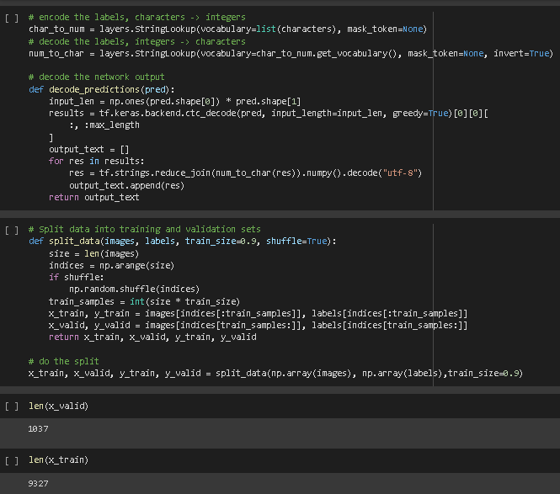
Here we used hot-encoder to turn all labels and characters to numerical value (0,1)
Then we split our data into training sets and validation sets (test set)
Then We get the length of the training data and validation data

Slide 8
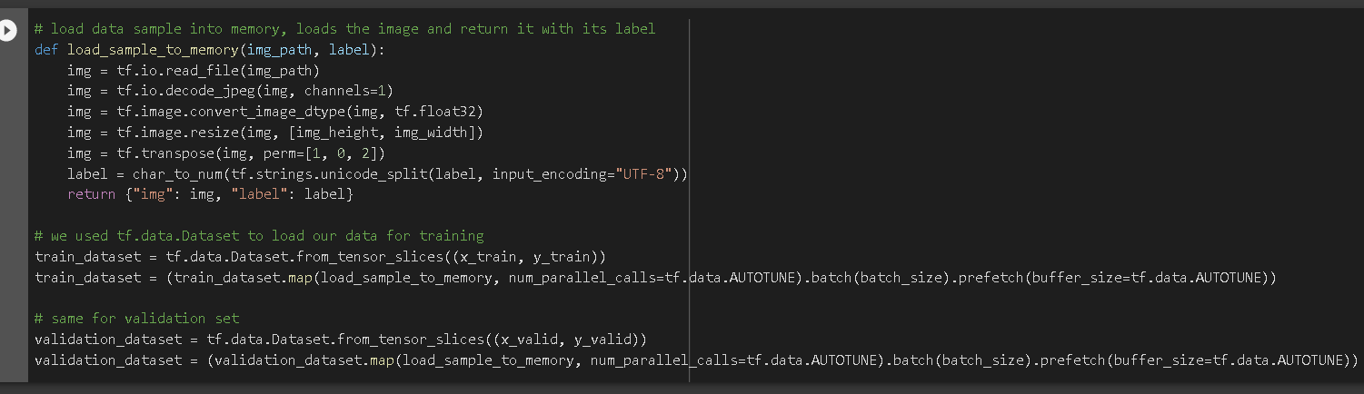
We here load our data sample into the memory , loads the image and return it with its label
We used tf.data.dataset to load our data for training and validation set (test set)

Slide 9
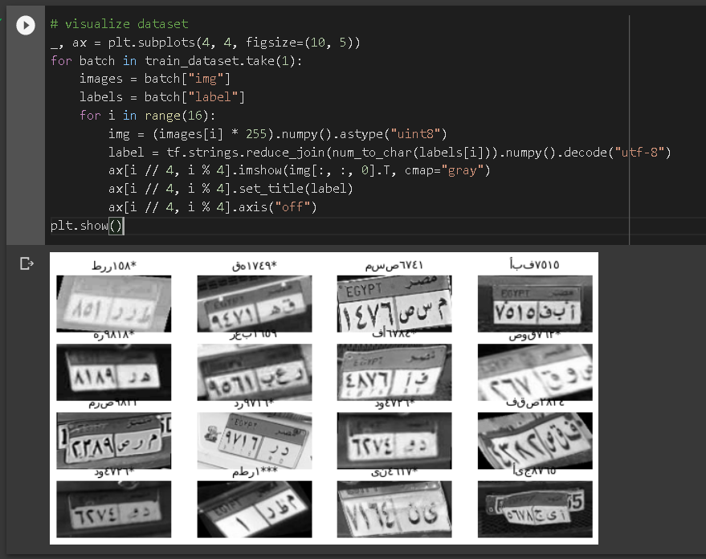
We use visualization for our training car plates data set as shown in the figure

Slide 10
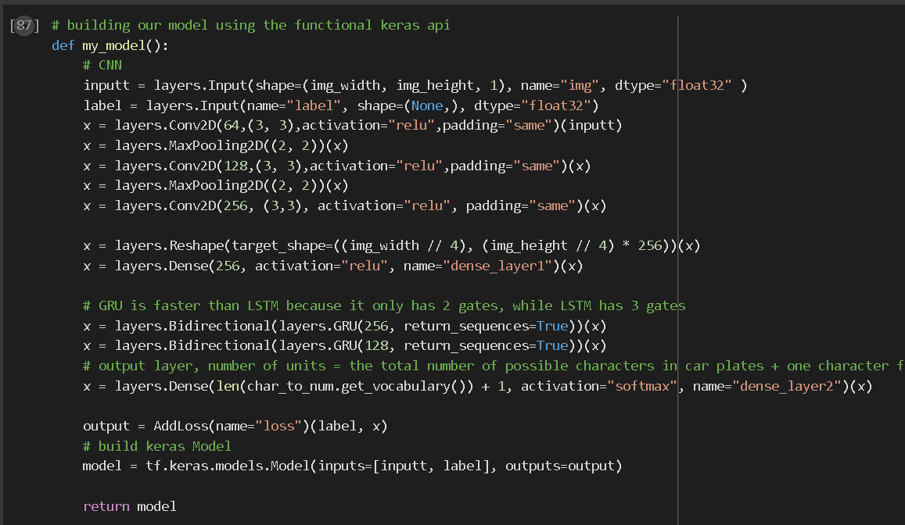
We build our model using the Functional Keras API
By using the Convolution Neural Network (CNN) , we used the filters and the Maxpooling to get more image details by multiply the number of pixils
And we use GRU because it faster than LSTM because it only has 2 gates, while LSTM has 3 gates
We used the softmax activation function which maximize layer Then we build Keras model

Slide 11
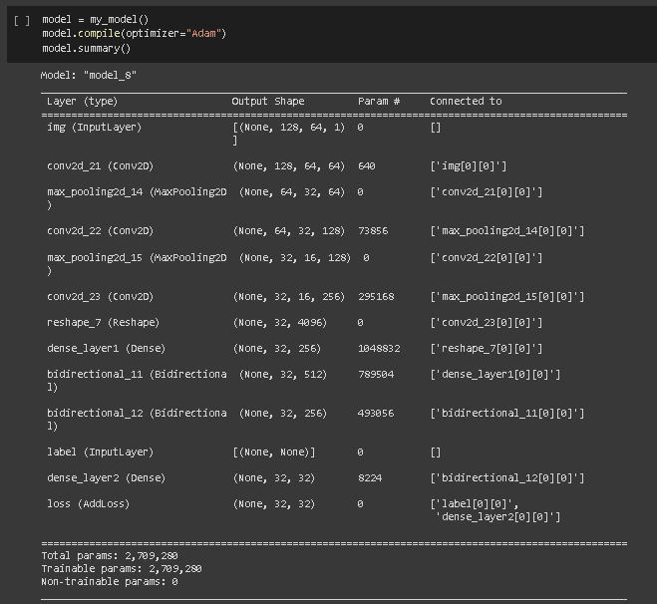
We used here an Adam optimizer and print out our model summary

Slide 12
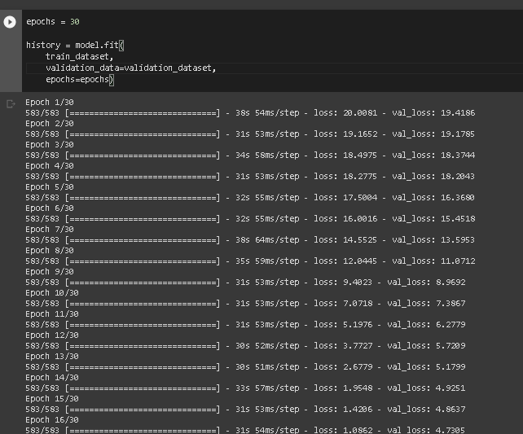
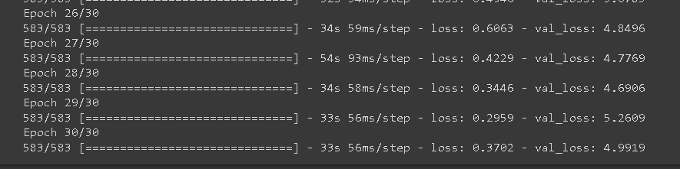
We trained our model 30 times by giving the model 30 epoch to achieve at the end 0.2959 loss and validation loss 4.9

Slide 13
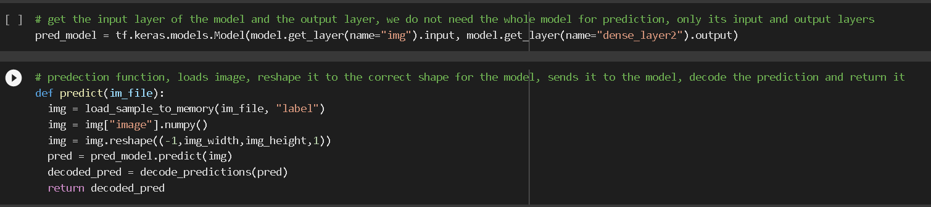
We get the input layer of the model and the output layer, we do not need the whole model for prediction, only its input and output layers
We used predection function, loads image, reshape it to the correct shape for the model, sends it to the model, decode the prediction and return it

Slide 14
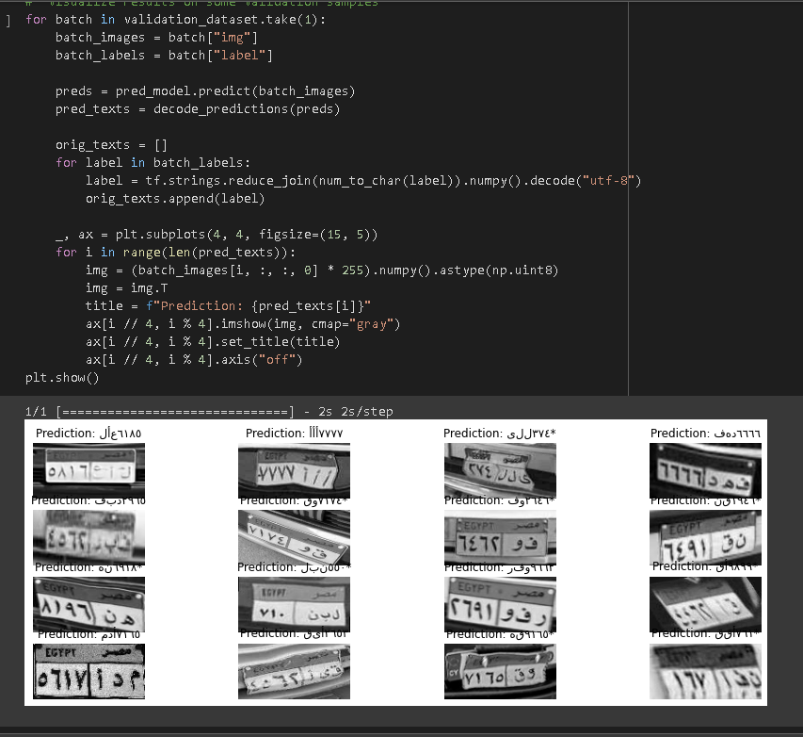
We display our final validation (testing) data model here by our prediction model that successfully extracts the labels from the image.

Slide 15
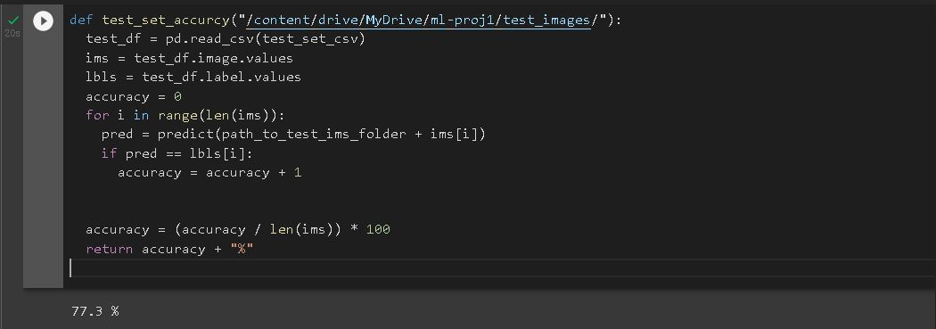
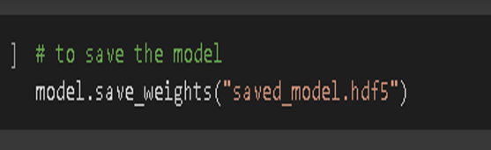
this is the function that calculate accuracy of the model by testing data contain labels and images and we got 77.3 %
Then we save our model for the next run

Slide 16

Thank You!

